Slide 3
Deadlock Handling in Centralized Systems
There are three classical approaches for deadlock handling, namely −
Deadlock prevention.
Deadlock avoidance.
Deadlock detection and removal.

Slide 4
Deadlock Prevention
The deadlock prevention approach does not allow any transaction to acquire locks that will lead to deadlocks.
The convention is that when more than one transactions request for locking the same data item, only one of them is granted the lock.
transaction acquires all the locks before starting to execute and retains the locks for the entire duration of transaction. If another transaction needs any of the already acquired locks, it has to wait until all the locks it needs are available.

Slide 5
Deadlock Avoidance
It analyzes the transactions and the locks to determine whether or not waiting leads to a deadlock.
There are two algorithms for Deadlock Avoidance : wait-die and wound-wait.

Slide 6
Wait-Die − If T1 is older than T2, T1 is allowed to wait. Otherwise, if T1 is younger than T2, T1 is aborted and later restarted.
Wound-Wait − If T1 is older than T2, T2 is aborted and later restarted. Otherwise, if T1 is younger than T2, T1 is allowed to wait.

Slide 7
Deadlock Detection and Removal
runs a deadlock detection algorithm periodically and removes deadlock in case there is one.
there are no precautions while granting lock requests, some of the transactions may be deadlocked. To detect deadlocks, the lock manager periodically checks if the wait-forgraph has cycles. If the system is deadlocked, the lock manager chooses a victim transaction from each cycle. The victim is aborted and rolled back

Slide 8
Choose the youngest transaction.
Choose the transaction with fewest data items.
Choose the transaction that has performed least number of updates.
Choose the transaction having least restart overhead.
Choose the transaction which is common to two or more cycles.

Slide 9
Deadlock Handling in Distributed Systems
The two main deadlock handling concerns in a distributed database system that are not present in a centralized system are transaction location and transaction control.
Once these concerns are addressed, deadlocks are handled through any of deadlock prevention, deadlock avoidance or deadlock detection and removal.

Slide 10
Transaction Location
Transactions in a distributed database system are processed in multiple sites and use data items in multiple sites. The amount of data processing is not uniformly distributed among these sites. The time period of processing also varies. Thus the same transaction may be active at some sites and inactive at others. When two conflicting transactions are located in a site, it may happen that one of them is in inactive state. This condition does not arise in a centralized system. This concern is called transaction location issue.

Slide 11
Transaction Control
Transaction control is concerned with designating and controlling the sites required for processing a transaction in a distributed database system. There are many options regarding the choice of where to process the transaction and how to designate the center of control, like −
One server may be selected as the center of control.
The center of control may travel from one server to another.
The responsibility of controlling may be shared by a number of servers.

Slide 12
Types of Distributed Deadlock
Resource Deadlock: A resource deadlock occurs when two or more processes wait permanently for resources held by each other.
A process that requires certain resources for its execution, and cannot proceed until it has acquired all those resources.
It will only proceed to its execution when it has acquired all required resources.
It can also be represented using AND condition as the process will execute only if it has all the required resources.
Example: Process 1 has R1, R2, and requests resources R3. It will not execute if any one of them is missing. It will proceed only when it acquires all requested resources i.e. R1, R2, and R3.

Slide 13
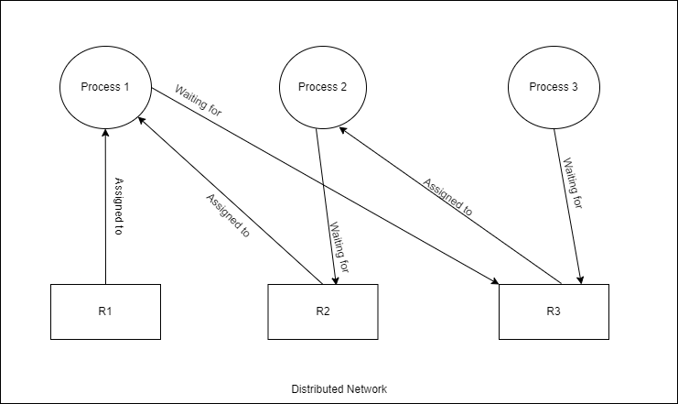
Example
Process 1 has R1, R2, and requests resources R3.
It will not execute if any one of them is missing.
It will proceed only when it acquires all requested resources
i.e. R1, R2, and R3.

Slide 14
Communication Deadlock
Communication deadlock occurs among a set of processes when they are blocked waiting for messages from other processes in the set in order to start execution but there are no messages in transit between them.
Process requires resources for its execution and proceeds when it has acquired at least one of the resources it has requested for.
Here resource stands for a process to communicate with.
Here, a Process waits for communicating with another process in a set of processes. In a situation where each process in a set, is waiting to communicate with another process which itself is waiting to communicate with some other process, this situation is called communication deadlock.
For 2 processes to communicate, each one should be in the unblocked state.
It can be represented using OR conditions as it requires at least one of the resources to continue its Process.

Slide 15
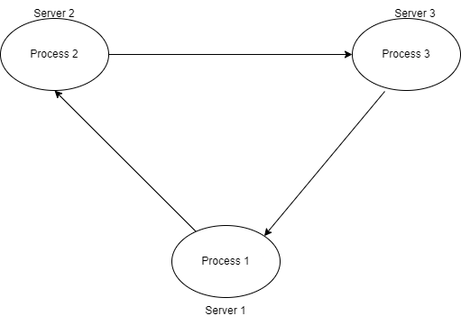
Examples
Process 1 is trying to communicate with Process 2, Process 2 is trying to communicate
with Process 3 and Process 3 is trying to communicate with Process 1.

Slide 16
Parameter | Resource Deadlock | Communication Deadlock
Definition | Resource deadlock refers to the deadlock state when the resource required by the first process is locked by the second one and the resource required by the second process is locked by the first process. | In distributed systems, communication deadlock refers to a state when processes are waiting for the messages to start the execution.
Execution | A process cannot start running until it obtains all of the resources it is waiting for. | A process cannot start executing until it can communicate with one of the processes it is waiting for.
Waiting for | Here, processes wait for the resources. | Here, processes wait for the messages.
Set of processes | The process set is resource deadlocked if each process in the set wants resources that are using by another process in the set and must get all of the required resources to become unblocked. | The set is communication Deadlocked if each process in the set is waiting to communicate with another process in the set, and no process in the set ever initiates any more communication until it receives the communication for which it is waiting.
Condition for execution | The AND condition can also be used to reflect the fact that the process will only run if it has all of the requisite resources. | Because it requires at least one of the resources to continue its Process, it can be described using OR conditions.

Slide 17
Necessary Conditions for Deadlock in Distributed System
The necessary and sufficient conditions for deadlock in a distributed system. These conditions are also known as Coffman conditions.
Mutual Exclusion: This condition implies the existence of atleast one resource in the system which can be used by only one process at a given point in time.
Hold and wait: This condition implies the existence of a process holding some resources and waiting for another one that is held by some other process in the system.
No Preemption: This condition implies that resources once allocated to a process cannot be taken away until and unless the process voluntarily releases them.
Circular wait: This condition refers to the waiting of processes in a circular manner where the last process waits for the resource which is held by the first one.

